Slide 1
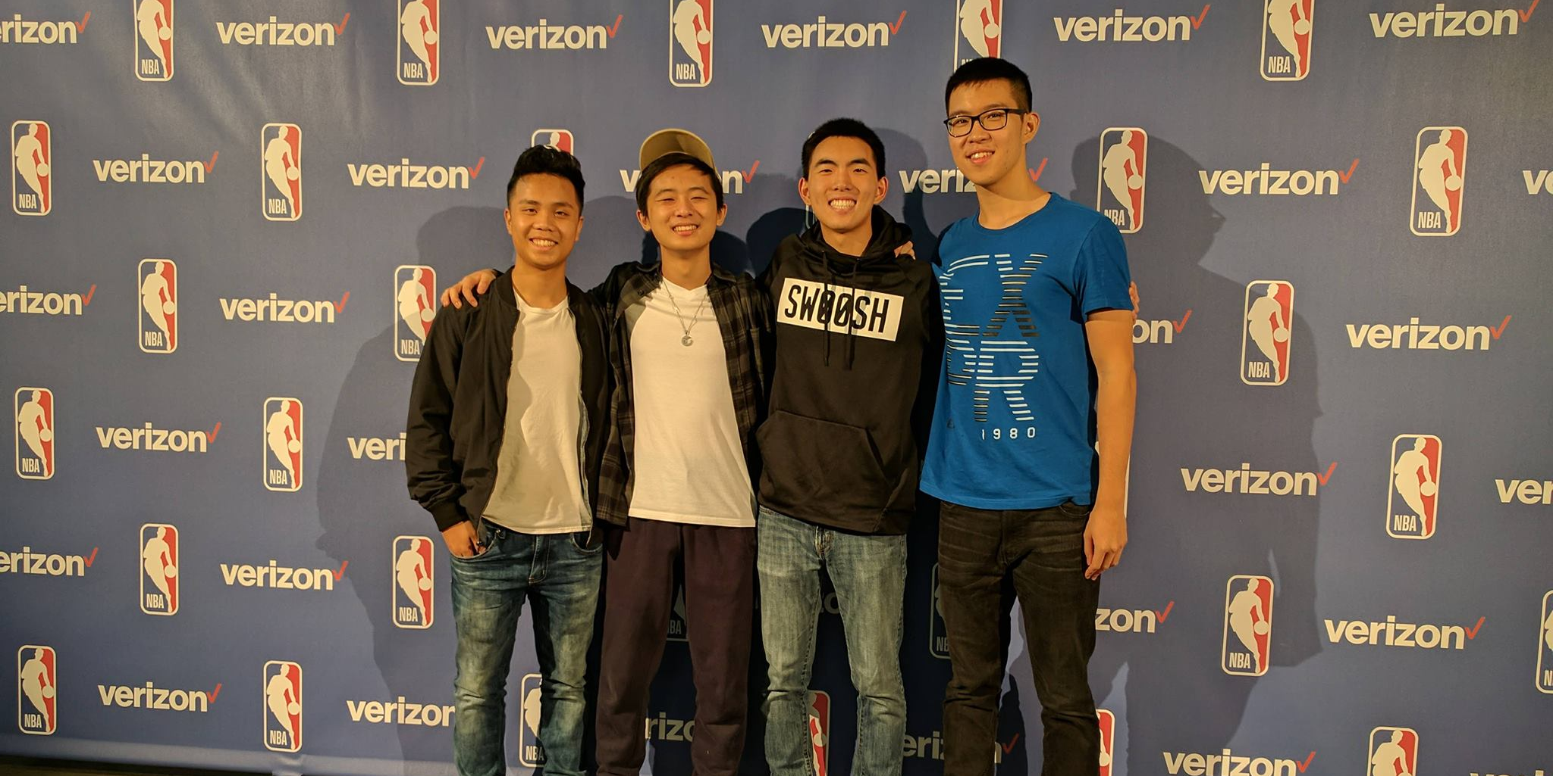
Quantifying Playmaking Ability and Offensive IQ
2BUCKETZ
Calvin Lui, Michael You, Wilson Yu, Richard Zhao

Slide 2
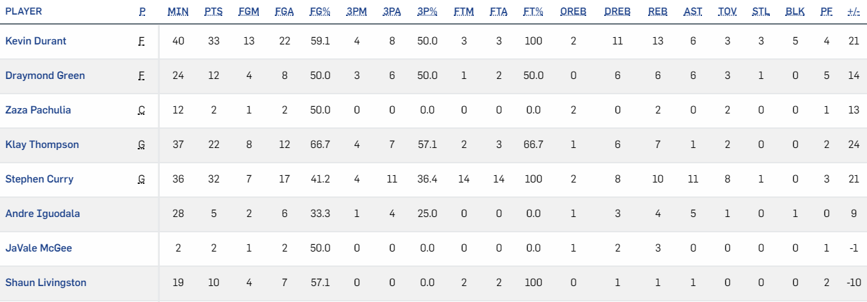
Background
Box score stats do not always accurately depict what happened in a game; merely a summary of the game.
Current advanced metrics do not assess playmaking ability and offensive IQ.
2
2

Slide 3
Solution
Subtitle
Present core box stat scores in real time and in a radar graph to show player tendencies and offensive IQ.
Show visualization of game in real time for more context.
Introduce a new statistic to measure a player’s ability to make the correct play.
3
3

Slide 4
Methodology
Subtitle
Used pandas and NumPy to organize and slice through data.
Used neural network regression to predict expected value of each shot and extrapolated said results to determine quality of shot taken.
Used SportsVU and d3.js to draw game and stats in real time.
4
4

Slide 5
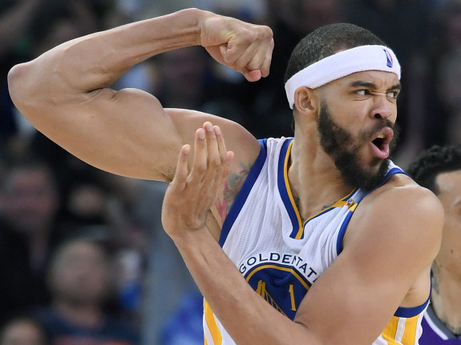
Conclusion
Subtitle
Stakeholders (viewers, coaches, and front offices) can all find use out of this new visualization and advanced statistic.
Allows for more accurate view of a player’s playstyle and offensive impact on the court.
Goes beyond simple stat counting.
5
5

